Slide 1

OR 603-Sports Analytics Case Study
Submitted by:
Srashti Agrawal

Slide 2
Agenda
Introduction
Research Techniques
Methodology and Data
Results and Discussions
Conclusion
Future Work

Slide 3
Introduction
Originated in South-east England in 18th century and become worldwide in 20th century.
In cricket, a team comprises of a group of 11 (eleven) players consisting of batsmen, bowler, wicket-keeper and all-rounder.
Types of matches
Twenty20- 20 overs per side (started in 2008)
One day International Match- 50 overs per side ( started in 1971)
Test Match- The test match is a two innings per team contest that is played over five days. (1877)
Objective of game
The main objective of each team is to score more runs than their opponents.[3]

Slide 4
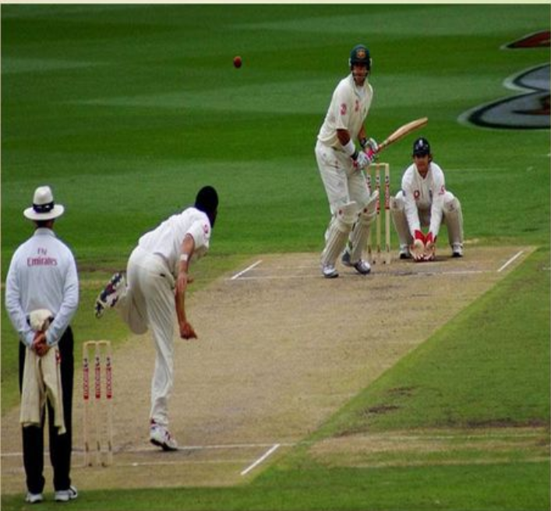
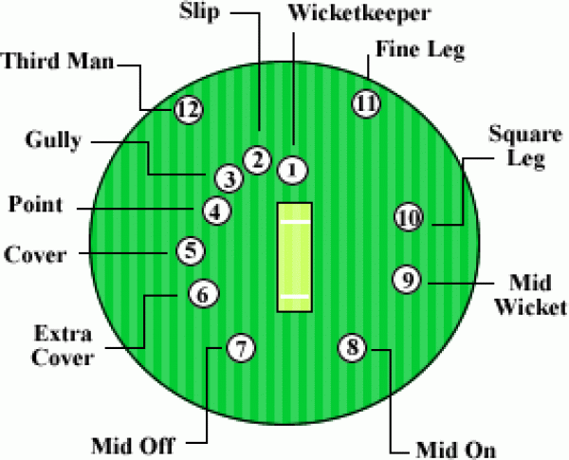
Field Position
Important field position on ground.

Slide 5
Case Study Information:
Research done in 2017 for International journal of Advance Research.
Objective: A study on Performance of Cricket Players using Factor Analysis Approach. The findings of this study reveals that batting capability dominates over bowling capability[1].
Dataset:
IPL9, 2016 - 85 batsmen, 85 bowlers;
ICC World Cup, 2015 - 95 batsmen, 95 bowlers
Available in the website: www.icc-cricket.com and www.espncricinfo.com.

Slide 6
Different Research Techniques
Ledesma and Mora discussed the number of factors to retain in exploratory factor analysis.
Swartz et al. predicted the number of runs of a particular one-day cricket matches with the help of simulation technique.
Norman and Clarke applied dynamic programming to determine optimal batting orders of a match. Whereas, Sharp et al. used an integer programming to determine the optimal team based on player’s performance in twenty20 cricket.
Lemmer shows how integer optimization, an objective scientific method, can be used to aid in selecting a cricket team.
Sharma used factor analysis approach in performance analysis of the players in IPL5-T20 Cricket.

Slide 7
Methodologies and Data
FACTOR ANALYSIS is a statistical technique to study the interrelationship among variables in an effort to find a new set of factors.
The purpose of factor analysis is to obtain a reduced set of uncorrelated latent variables using a set of linear combinations of the original variables to maximize the variance of these components.
The factor analysis which was performed using Principal Component Analysis (PCA) as it identifies interrelationships between variables.[2]
An orthogonal varimax rotation was used as it assists in optimizing the number of variables.

Slide 8
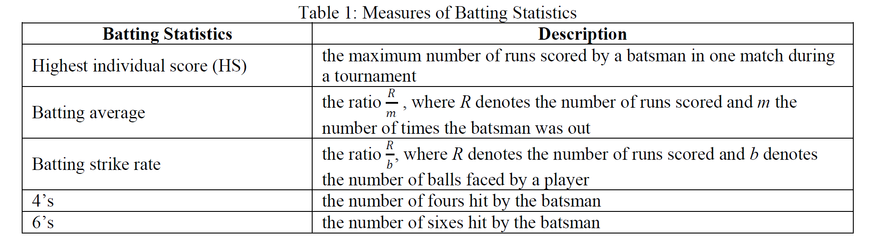
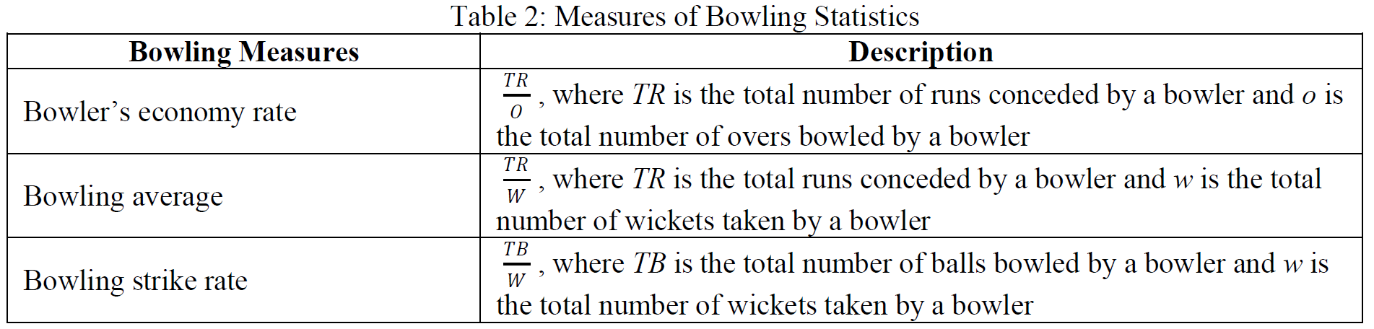
Measure of Bowling and Batting Statistics For study, the performance of players were measured:

Slide 9
Important Term
Eigen Vectors and Eigen Values:
Let A be a N x N Matrix, Scalar "λ" is called Eigen value of A if there is a nonzero vector x̅, such that Ax̅ = λx̅. Such a vector x̅ is called an eigenvector of A corresponding to λ.
Ax̅ = λx̅
Communalities: are computations of the extent to which a variable is explained by the components.[2]
The rotated component matrix: sometimes referred to as the loadings, is the key output of principal components analysis. It contains estimates of the correlations between each of the variables and the estimated components.[2]

Slide 10
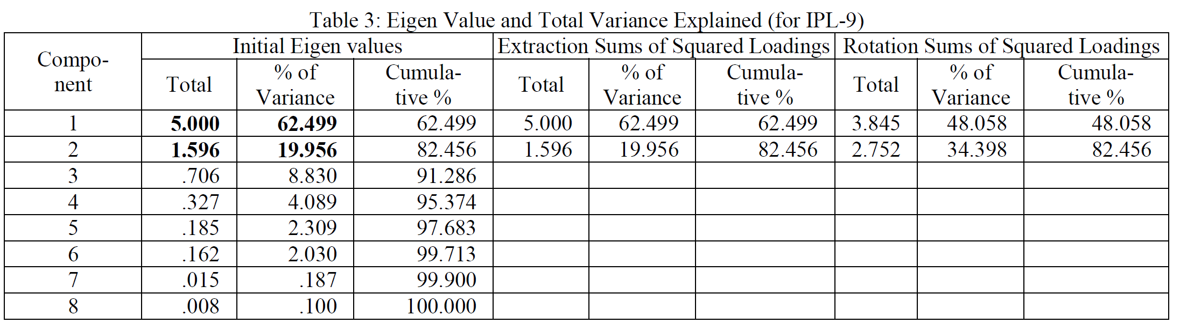
Variance explained by Method for IPL 9 The analysis shows that the 8 original variables can be reduced to 2 underlying factors. The first component explains more of the variance than the second component.

Slide 11
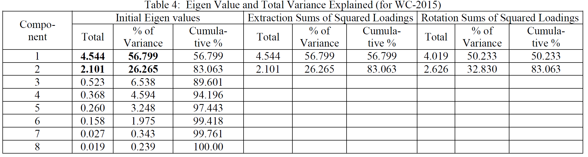
Variance explained by Method for WC 2015

Slide 12
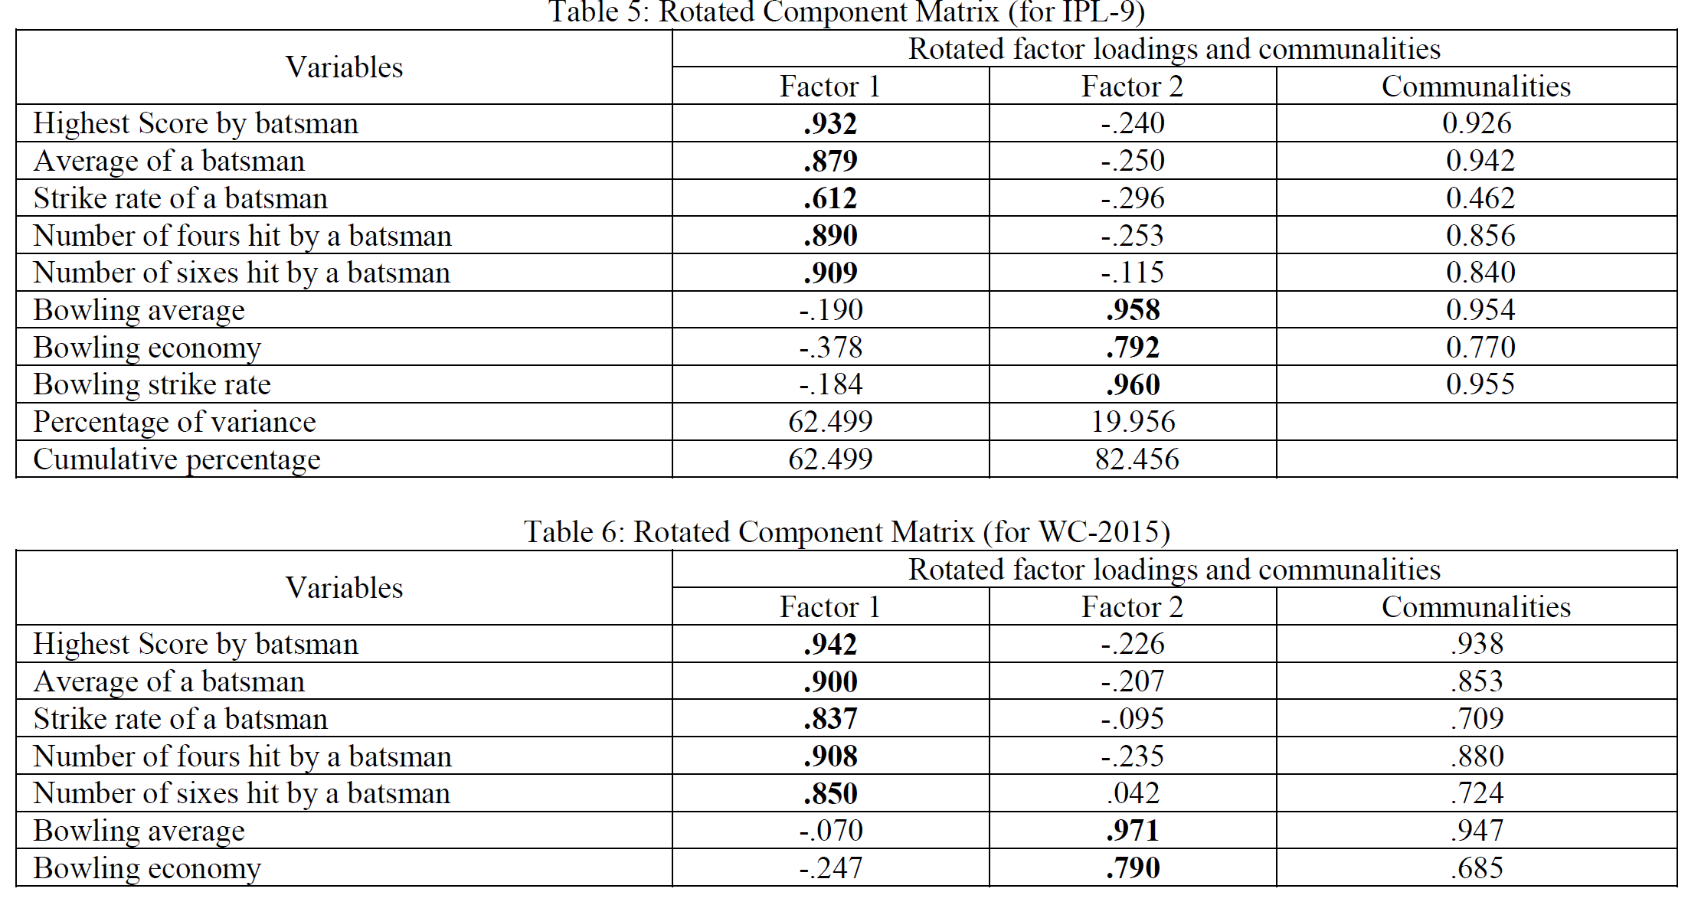
Rotated component Matrix

Slide 13
Consideration of Factors
In selecting the extraction of factorial groups, the Kaiser criterion was adopted. As per the Kaiser Rule, all factors should be accepted whose eigen values are higher than 1.0.
Considered only those items whose factor loading are higher than 0.5.
Therefore, two factors were extracted, the same has been presented graphically.

Slide 14
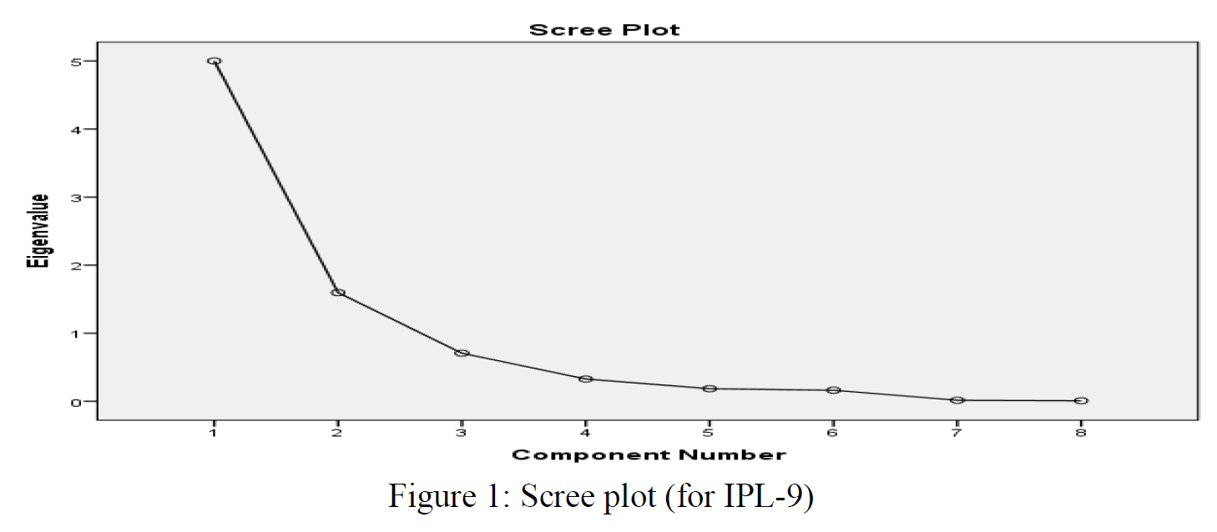
Cattell’s Scree Plot for IPL-9, 2015

Slide 15
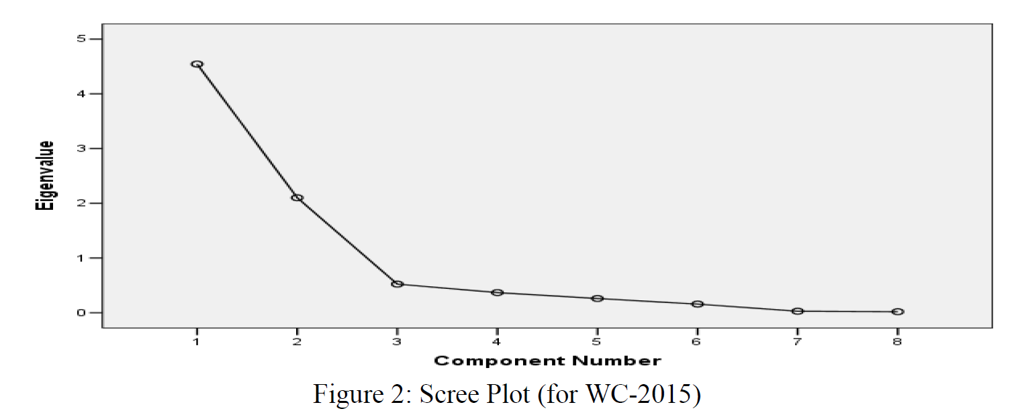
Cattell’s Scree Plot for World cup 2015

Slide 16
Results and Discussions
For IPL, the variance (i.e., batting) is 62.50 % and the variance of second factor (i.e., bowling) is 19.96 %, that accounted to 82.46 %.
In case of ICC World Cup, 2015, the variance (i.e., batting) is 56.80 % and the variance by second factor (i.e., bowling) is 26.26 %. That accounted for 83.06 % of the total variance explained in this study.
Thus, the variance explained by batting is much higher than the variance explained by bowling.
This shows the higher importance of batting as compared to bowling in ICC World Cup Cricket, 2015 and IPL -9 2016.

Slide 17
Conclusion
The batting capability dominates over bowling capability.
we cannot generalized it since some other factors such as geographical location, type of pitch conditions, weather conditions, effect of lighting in day-night matches etc. may impact on the performance of players.

Slide 18
Future work
We can add some more variables to make better conclusion.
Increase our data set.

Slide 19
References
1. www.ijarcs.info.
2. https://docs.displayr.com/wiki/Category:Principal_Components_Analysis#Rotated_Component_Matrix
3. https://en.wikipedia.org/wiki/Cricket

Slide 20

Thank you
Any Questions

